Slide 1

Water Heater Controls:
NW XP Energy Research
Ty Crabtree

Slide 2
Goals:
Determine whether it is preferable to use sub-metering or advance metering infrastructure (AMI) data.
Determine whether it is preferable to use centralized or distributed intelligence.

Slide 3
Sub-Metering
Benefits:
  Accurate energy monitoring (no estimation, actual energy use).
  Beneficial to peak demand management.
  Decreases energy cost, 0-2%, in the short-run.

Slide 4
Sub-Metering
Negatives:
  High installation costs.
  Energy habits are unchanged in the long run, residentially.

Slide 5
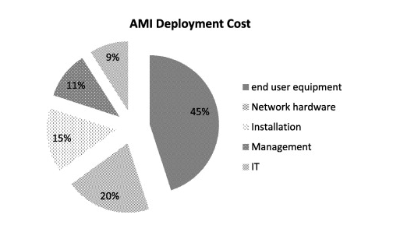
Advance-Metering Infrastructure
Benefits:
  Cheaper installation.
  Can provide communication and help locate power outages.

Slide 6
Advance-Metering Infrastructure
Negatives:
  Can be unsafe in terms of security. Data theft may occur with sending detailed data and storing that data in multiple places.
  Eliminating aggregate data eliminates privacy.
  Possible power theft and power manipulation.

Slide 7
Centralized Intelligence
Benefits:
  Low overhead costs
  Low component costs.

Slide 8
Centralized Intelligence
Negatives
  High amount of cables.
  Expensive repairs.

Slide 9
Distributed Intelligence
Benefits:
  Allows for precision.
  Minimal installation costs.
  Better for complicated systems.

Slide 10
Distributed Intelligence
Negatives:
  Potential damage to the system from outside sources.
  Wiring and component costs are higher than centralized intelligence.

Slide 11
Conclusion
Determine whether it is preferable to use sub-metering or advance metering infrastructure (AMI) data.
      Sub-metering.
Determine whether it is preferable to use centralized or distributed intelligence.
      Distributed intelligence.

Slide 12
Citations
http://www.setra.com/blog/what-are-the-benefits-of-submetering/2015/03/23
http://www.sciencedirect.com/science/article/pii/S0142061514003743
http://www.securitymagazine.com/articles/76457-central-vs-distributed-1

